Slide 1
Heuristic Evaluation
and Usability Testing
Group member: Piotr, 鄭敬儒, 鄭欽安

Slide 2
Heuristic Evaluation
Goals and Research Questions
The main goal of the heuristic evaluation is to identify problems with the UI design of the Skyscanner, analyze the severity of the problems and finally create solutions based on standards, conventions and good practices.
Can design of the Skyscanner be considered “good”?
Do the website have problems with high severity?
How can the identified problems be solved and what are the recommended action according to conventions and best practices?
What can we learn from Skyscanner?

Slide 3
Our Process
TASKS
Individual Evaluation
Group
Evaluation
Judge the severity and priority
Defining key scenarios and tasks connected with the usage of the website:
  - Finding flights (best ratio of
  price/time, best price, best time)
  - Finding hotels (by price,
  location, user ratings, stars)
  - Renting Car(class, type, pick
  up, features, star rating etc)
Individual Evaluation: all of the team members perform complete evaluation and create brief description of the problem
Individual rating of the severity of the problem and comparison to the rest of the group
Group Evaluation: comparison of our ratings
Judging which problems with the UI of Skyscanner can cause biggest user problems

Slide 4
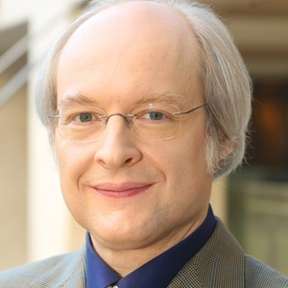
Method
Nielsen’s heuristics:
Visibility of system status
The system should always keep users informed through appropriate feedback within reasonable time.
Match between the system and the real world
The system should speak the users' language, with words, phrases and concepts familiar to the user, rather than system-oriented terms. Follow real-world conventions, making information appear in a natural and logical order.
User control and freedom
Users often choose system functions by mistake and will need a clearly marked "emergency exit" to leave the unwanted state without having to go through an extended dialogue. Support undo and redo.
Consistency and standards
The system should always keep users informed about what is going on, through appropriate feedback within reasonable time.

Slide 5
Method
Error prevention
Careful design that helps to prevent user making mistakes
Recognition rather than recall
Minimize the user's memory load by making objects, actions, and options easily visible. The user should not be forced to remember information! Instructions how to use our system should be visible or easily retrievable whenever appropriate.
Flexibility and efficiency of use
Accelerators and shortcuts may often speed up the interaction for the expert user
Aesthetics and minimalist design
Dialogues should not contain information which are irrelevant to the users goals. Every extra unit of information in a dialogue competes with the relevant units of information and diminishes their relative visibility.
Help users recognize, diagnose, and recover from errors
Error messages should be expressed in plain language (no codes), precisely indicating the problem, and constructively suggest a solution.
Help and documentation
It is necessary to provide users with documentation, which should be easy to search, process and use.

Slide 6

Tasks
- Login to the Skyscanner using provided credentials
- Your friend from Poland invited you to Warsaw. You decide to depart from Taipei at 30/11/2018 and take one way ticket. You know that he will arrive to Warsaw long before you, so you decided to take the fastest flight
- After very long year of hard work you decided to take a flight to Paris and rent a luxury hotel. You want to depart 30/11/2018 and return 09/12/2018. You want to land on Charles de Gaulle airport. You want to take the best possible flight when it comes to the price/time ratio. During this time you want to reserve the best hotel when it comes to the user ratings.
- During winter vacation, you want to take a trip to Tokyo with your friend for five days. Because you are students, you decided to find the cheapest round-trip tickets in January.
- The typhoon is coming soon. The reporter said it will land on 2018/10/31. And now you are in Tokyo. So you need to back to Taipei before Typhoon coming. And you want to choose a cheapest ticket. Now, you only have a smartphone. So you need to use it to book a ticket.

Slide 7

Findings

Slide 8
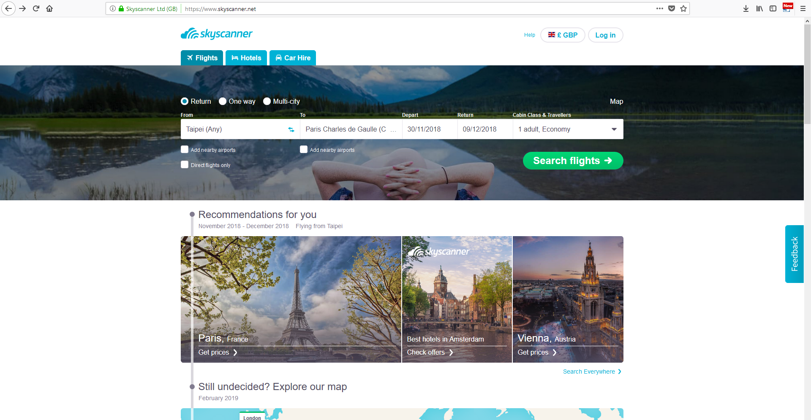
Positive finding: Clean design and clear layout
Heuristics: Visibility of system status, aesthetics and minimalist design
Description: The website is easily navigable, have clean layout that doesn’t take the users focus from the tasks

Slide 9
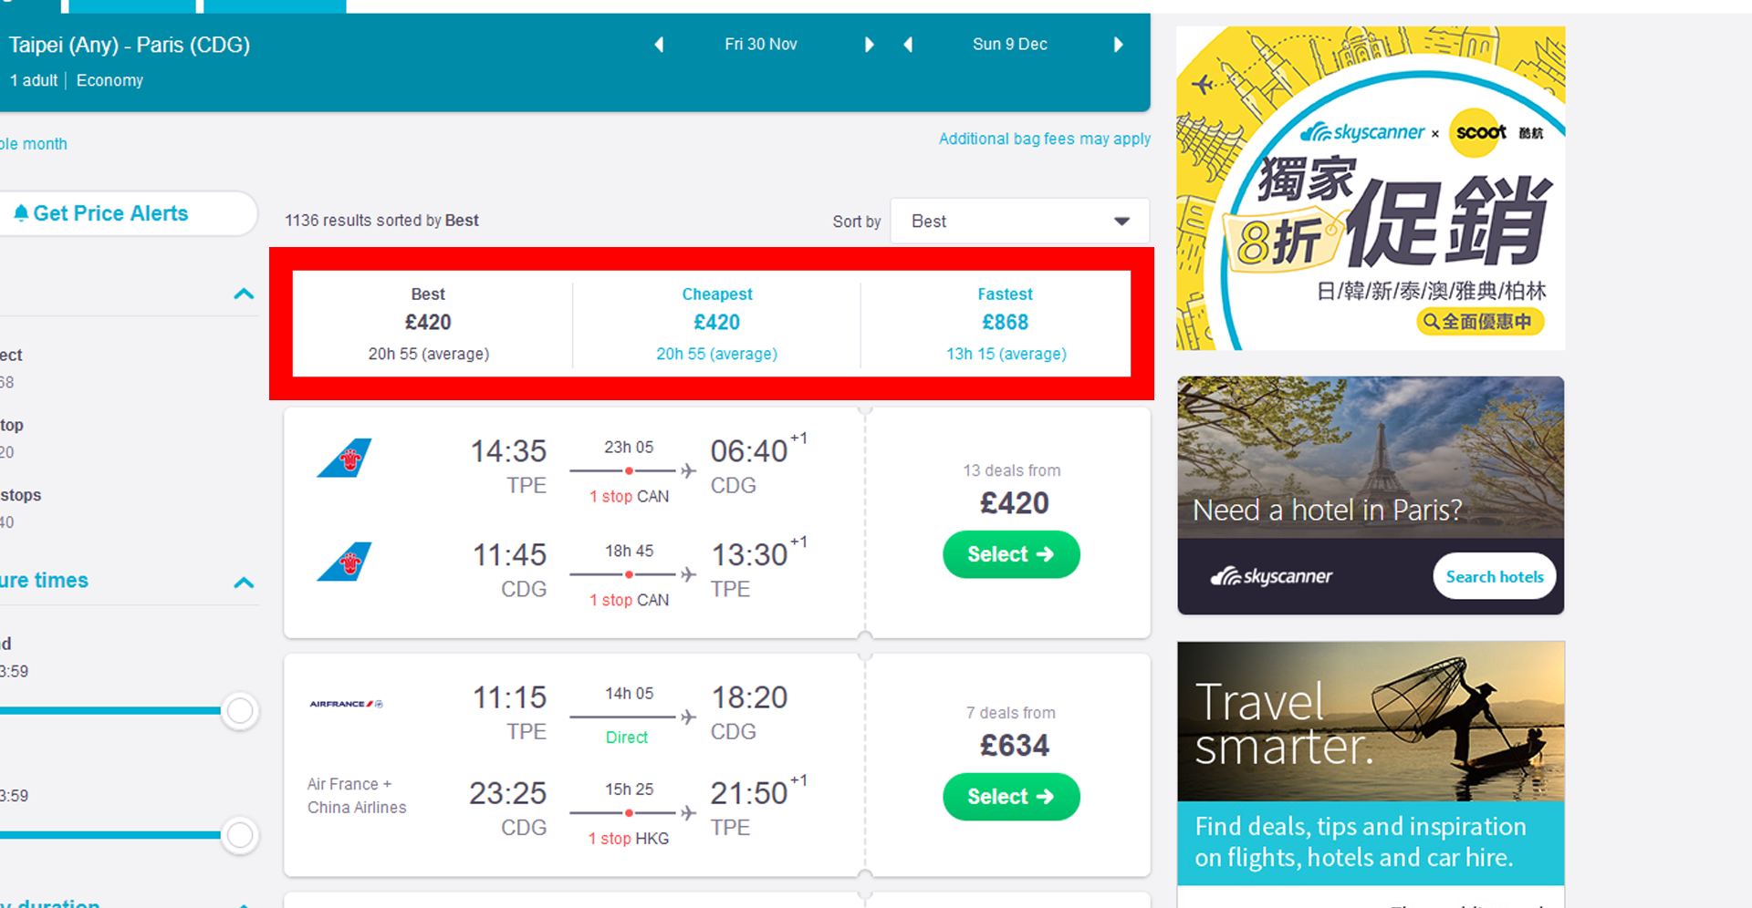
Positive finding: The search engine does the price/time analysis
Heuristics: Visibility of system status, flexibility and efficiency of use
Description: websites engine analyse the prices and time for the user, what makes the tasks easier and more efficient.

Slide 10
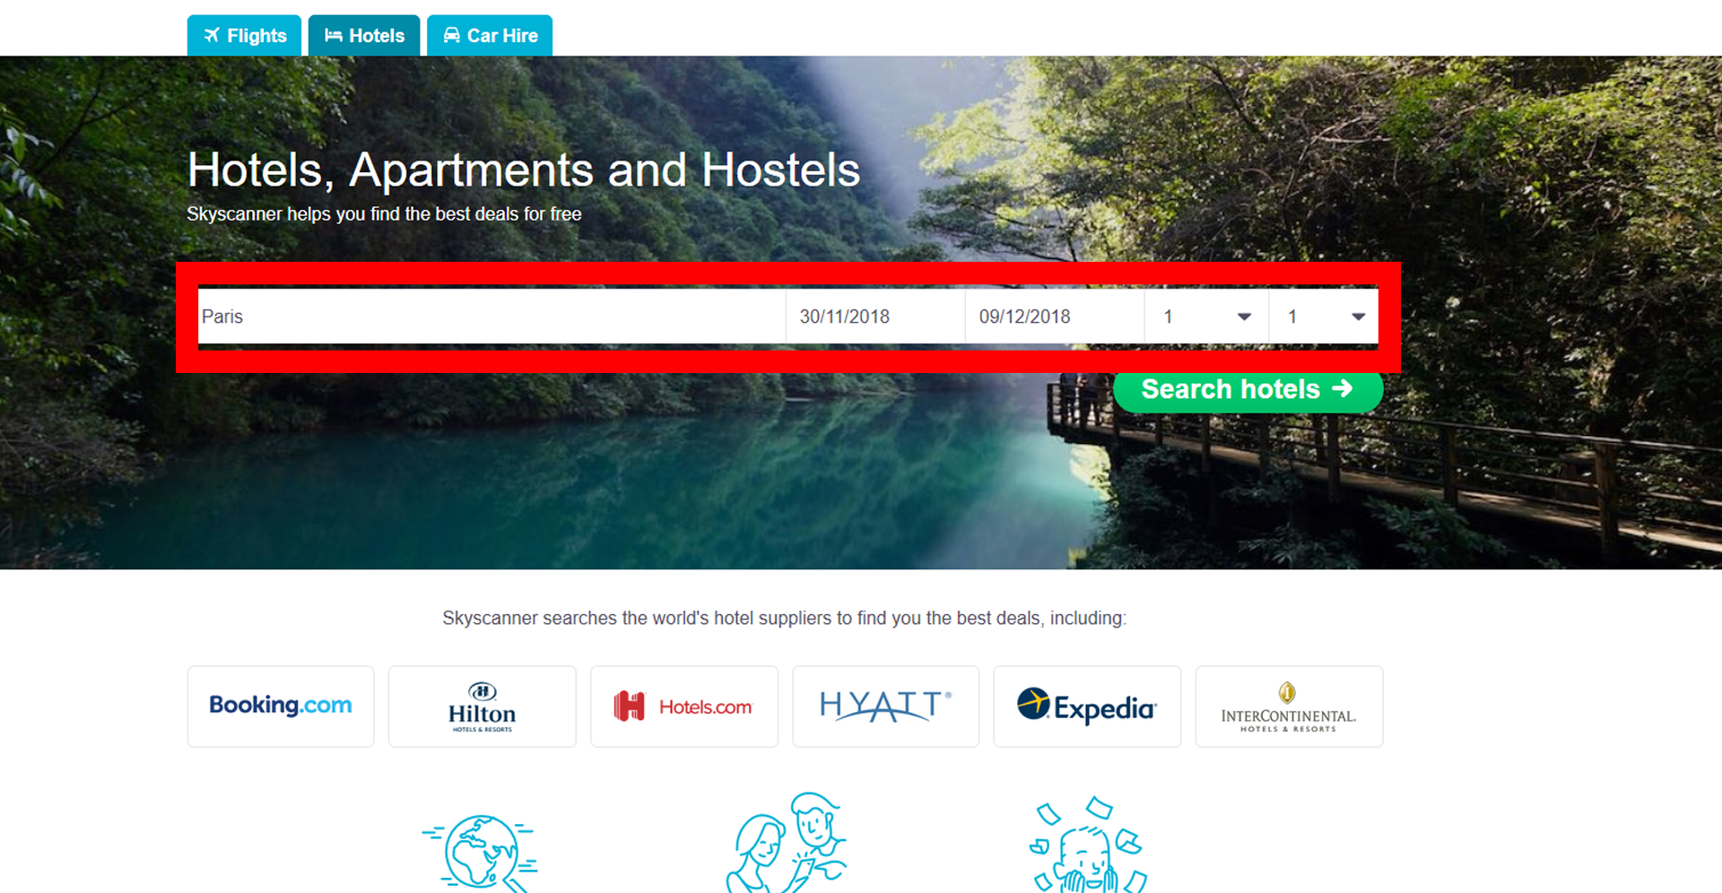
Positive finding: Website remembers our search
Heuristics: Flexibility and efficiency of use, error prevention,
Description: The website have very helpful feature - when we are looking for car/hotel after searching for the flight, the localization and date are already there for us. After I searched for flight from Taipei to Paris and clicked the Hotels tab, it already showed the Paris and the right dates

Slide 11
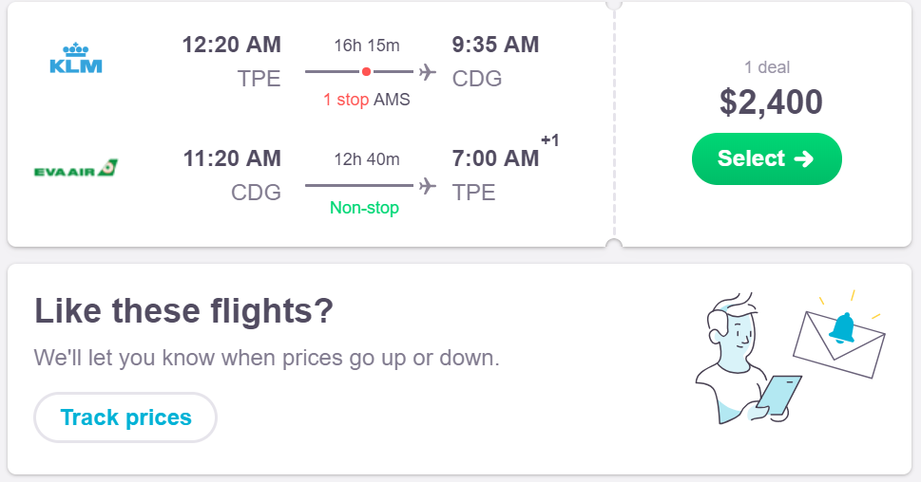
Positive finding: Tracking the price changing
Heuristics: Flexibility and efficiency of use, error prevention,
Description: Because the price of ticket always change. When we still not sure which ticket we will buy, we can track the price by this function.

Slide 12
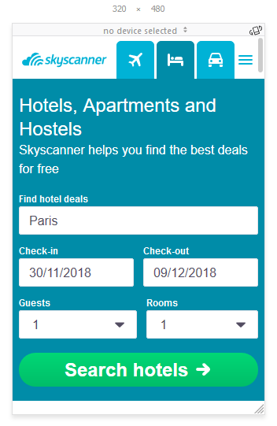
Problem: Main Menu is hard to access in lower resolutions
Heuristic violations: Aesthetics and minimalist design, error prevention
Severity: 2
Description: While using older cell phones/lower screen resolution the menu is hard to access.

Slide 13
Recommendation
Make the logo and tabs a little bit smaller, make the hamburger menu bigger

Slide 14
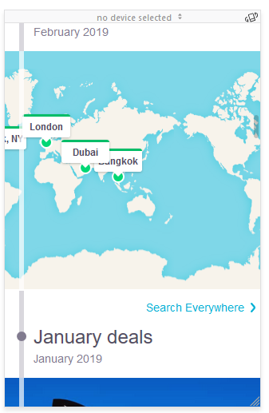
Problem: In some parts there is a problem with responsive design
Heuristic violations: Aesthetics and minimalist design
Severity: 2
Description: While the problem is relatively small, it might destroy the general users impression

Slide 15
Recommendation
Carefully check the css width scaling of particular elements

Slide 16
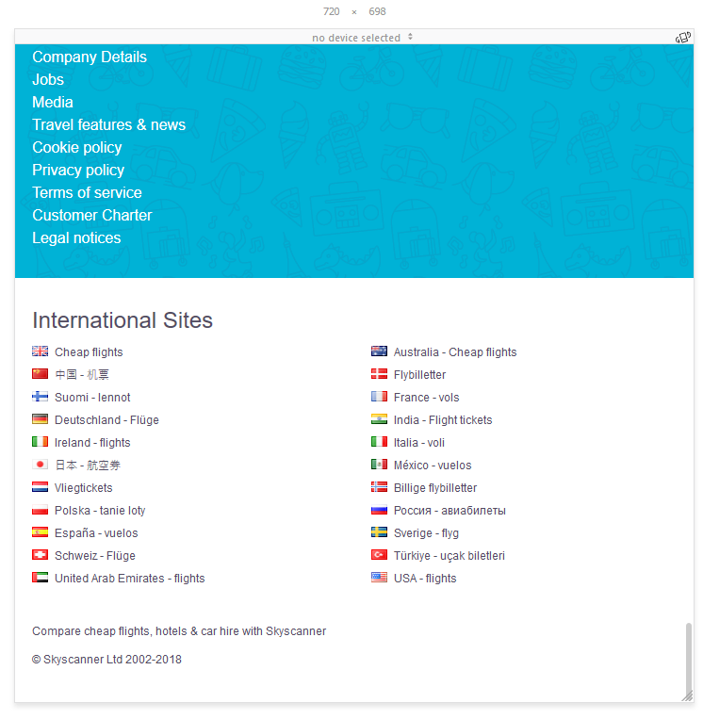
Problem: Links and their pictures are too small
Heuristic violations: Error prevention, flexibility and efficiency of use
Severity: 2
Description: While it's great that we can access dedicated websites in our languages, the links are too small and it is very easy to click on the wrong one when we are using cellphone.

Slide 17
Recommendation
Make the flags and links bigger

Slide 18
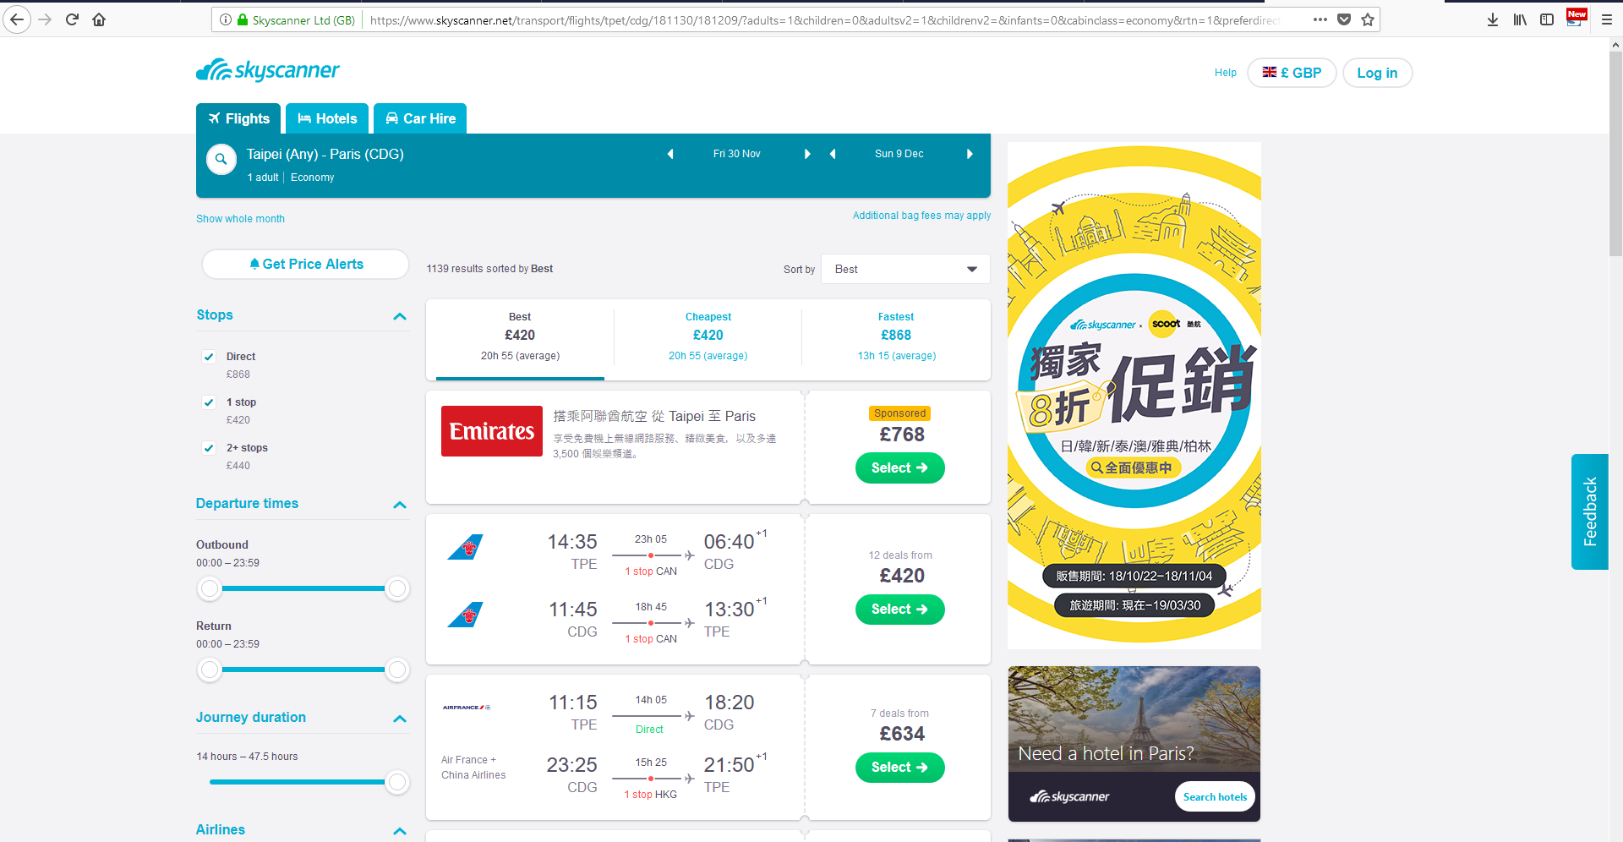
Problem: Commercials take too much space
Heuristic violations: Error prevention, visibility of system status, aesthetics and minimalist design
Severity: 3
Description: Comparing to the content, commercials take too much space, especially that the main container doesn’t take full width. Because of that, the fonts of the content are small and might be hard to see for an older person.

Slide 19
Recommendation
Either resize the commercial banners so the main content can be made bigger or resize the whole main container.

Slide 20
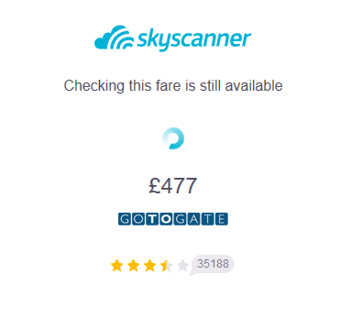
Problem: Inconsistent pricing
Heuristic violations: Visibility of system status, consistency and standards
Severity: 3
Description: While most of the time prices on the Skyscanner are accurate, it happens far too often that they changes when we are directed to the website, where we can buy a ticket. It seems strange, since the user have to wait for the prices to load after choosing his directions and dates.

Slide 21
Recommendation
Actualize the Skyscanners database more often, so the sure doesn’t have to wait two times and, in case of the different price, doesn’t have to star the whole process all over again

Slide 22
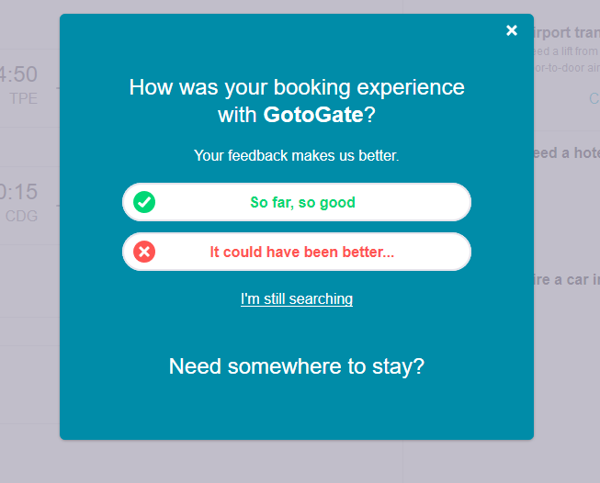
Problem: Annoying questionnaire
Heuristic violations: Visibility of system status, aesthetics and minimalist design
Severity: 1
Description: After we are redirected to the GotoGate, which opens in the new window, when we come back to the Skyscanner website, we are welcomed with the pop-up ad. After going through the comments, we found that a lot of users find it irritating.

Slide 23
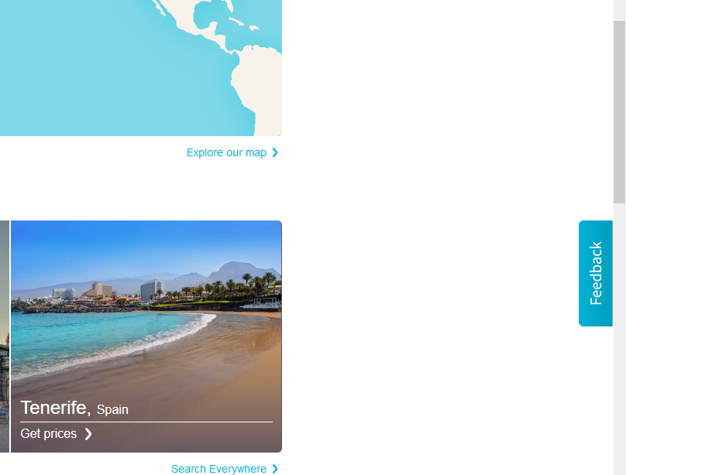
Recommendation
Find different moment to ask, or add this question to the feedback that shows on the right side of the main webpage.

Slide 24
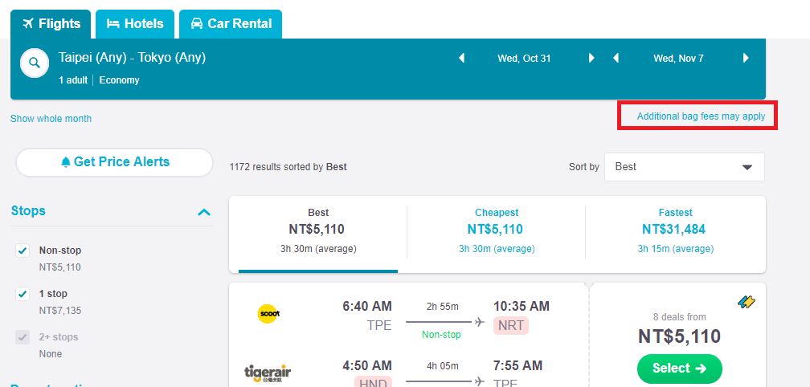
Problem: Bag fee price is not clear
Heuristic violations: Error prevention
Severity: 3
Description: it's hard for users to notice that "Additional bag fees may apply". Some of prices contains the bag fees, but some don't. This will confuse the users especially first-time users.

Slide 25
Recommendation
Resize the text of “Additional bag fees may apply”. If not impossible, indicate whether the prices contain bag fee or not.
Without bag fee

Slide 26
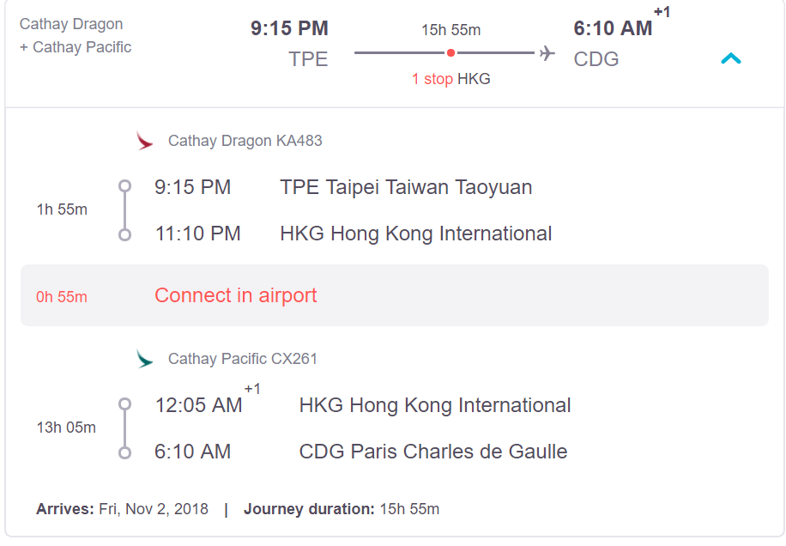
Problem: The time connect in the airport
Heuristic violations: Error prevention
Severity: 2
Description: For someone often going abroad remember to care about spending time connect in airport naturally. But for someone seldom going aboard, the time connect in airport should be aware. Because it may miss the flight, if the the time connect in airport is too short.

Slide 27
Recommendation
The time connect in the airport can show larger or in early step during searching flight
Larger to alert

Slide 28
Group evaluation
Problem | Peter | Henry | Chin-An
Main Menu is hard to access in lower resolutions | 2 | 2 | 2
In some parts there is a problem with responsive design | 2 | 2 | 2
Links and their pictures are too small | 2 | 2 | 2
Commercials take too much space | 3 | 3 | 2
Inconsistent pricing | 3 | 2 | 3
Annoying questionnaire | 1 | 1 | 1
Bag fee price is not clear | 3 | 2 | 3
The time connect in the airport | 2 | 2 | 2

Slide 29

Our evaluation
In our opinion Skyscanner is very useful and very well designed. Most of the problems have very low severity and don’t prevent user from full participation in Skyscanners features.
The main problem with the website is the lack of consistency with prices, what can be very irritating and demands from the user more focus than it should.
Although we fully understand that using the website is free and it probably gets most of its funds from commercials, they take too much space. Fortunately, this problem is also easy to solve.

Slide 30
Usability testing
Goals and Research Questions
The main goal of this usability test is to find out how users interact with the system while doing most common tasks. Heuristic analysis not only helped us to better understand the user interface and experience of the website, but also helped defining most common and probable scenarios and tasks connected with the usage of the website.
Finding flights (best ratio of price/time, best price, best time)
Finding hotels (by price, location, user ratings, stars)
Renting Car(class, type, pick up, features, star rating etc)
What is very important, those tasks might be connected (for example, someone can search for the flight to Paris and need a hotel and car during his stay)

Slide 31

Recruiting
What we tried to achieve:
Recruiting people with different backgrounds and traveling experience
Try to reach different age groups

Slide 32
Participants
Backgrounds:
1. Electrical Engineer, Male, 35 years old, has experience with skyscanner
2. EE NTHU undergraduate, male, 22 years old, never use skyscanner before
3. EECS NCTU Master Student, has little experience with skyscanner
4. PhD in Chemistry, Post-doc at NCTU, has experience with skyscanner

Slide 33
Introduction to Method
The setup and all the questions were first tested among the team. All of us, individually, went through all the tasks. We wanted to avoid system errors and prepare ourselves to make the actual test with “real people” go fluently.

Slide 34
Test settings
Test location
Equipement
Recording method
Scripts
Data logging
The location where we conduct the test
Camera, laptop
Camera and screen recorder
Prepared interview script (intro, post-questionnaire, outro)
Handwritten notes of incidents

Slide 35
Test structure
Intro
Tasks
Post
questions
Debrief
The user gets informed about the goal of the test, that his participation is voluntary and can be terminated at any time. We remind him/her that we are grading the system, not him/her.
We also inform that everything will be recorded, so we need our consent form signed and describe the tasks.
We focused on:
common tasks
multi-tasks
We start with easy warm-up tasks and steadily graduate the difficulty level
The post questionnaire goal is to check the experience and impressions of the user about the system.
Debriefing includes the general talk with the user about his impressions, questioning about the mistakes he/she did (if there are any) and how could those be avoided in the future, and outro script.

Slide 36

Taks rules
To evaluate the success rate we used 3-level scale:
Complete success (with and without assistance)
Partial success (with and without assistance)
Complete failure (with and without assistance)
Additionally, if the user is not able to complete the task by himself/herself, we provide small assistance and note the number of hints we had to give.

Slide 37
Layout
Equipment
Layout
Laptop (Windows OS)
Pen
Notes
Wifi/ Internet Connection
Recorder
Computer Screen Recorder
Video Recorder
1 table
4 chairs:
1 chairs for test participant
1 chair for note taker and/or camera operator
1 chair for moderator and/or technical support
1 chair for observer

Slide 38
Roles
Moderator :
Guide the test participant through the tasks
Read the scripts
Give hints
User:
Follow the instruction from the moderator
Inform about problems faced during test process
Note taker
Notes any activity during test process
Mark the tasks checklist based on task success criteria
Observer
Checks if moderator and note taker didn’t miss anything

Slide 39
Tasks
All the tasks are scenario-based, what should make the test more realistic. We start with easy, warm up tasks and gradually raise the level of difficulty.
Login to the Skyscanner using provided credentials: email: interactiondesignnthu2018@gmail.com, password: Nthu2018
Your friend from Poland invited you to Warsaw. You decide to depart from Taipei at 30/11/2018 and take one way ticket. You know that he will arrive to Warsaw long before you, so you decided to take the fastest flight.
After very long year of hard work you decided to take a flight to Paris and rent a luxury hotel. You want to depart 30/11/2018 and return 09/12/2018. You want to land on Charles de Gaulle airport. You want to take the best possible flight when it comes to the price/time ratio. During this time you want to reserve the best hotel when it comes to the user ratings.
During winter vacation, you want to take a trip to Tokyo with your friend for five days. Because you are students, you decided to find the cheapest round-trip tickets in January.
The typhoon is coming soon. The reporter said it will land on 2018/10/31. And now you are in Tokyo. So you need to back to Taipei before Typhoon coming. And you want to choose a cheapest ticket. Now, you only have a smartphone. So you need to use it to book a ticket.

Slide 40
Results
 | User 1 Taiwanese Experienced | User 2 Taiwanese Inexperienced | User 3 Foreigner Inexperienced | User 4 Foreigner Experienced
1 | F | F | F | F
2 | S | S | S | S
3 | S | S | S | S
4 | PS | S | S | S
5 | S | PS | S | S
LEGEND:
S : Success
PS: Partial Success
F : Failure

Slide 41
Analysis
Question:
Login to the Skyscanner using provided credentials:
email: interactiondesignnthu2018@gmail.com, password: Nthu2018
Purpose:
Warm up for usability testing
Analysis
  There are something wrong with our email account
  But when using user’s own account, it can login in successful
User 1 Taiwanese Experienced | User 2 Taiwanese Inexperienced | User 3 Foreigner Inexperienced | User 4 Foreigner Experienced
F | F | F | F

Slide 42
Analysis
Question:
Your friend from Poland invited you to Warsaw. You decide to depart from Taipei at
30/11/2018 and take one way ticket. You know that he will arrive to Warsaw long
before you, so you decided to take the fastest flight.
Purpose:
User is able to order fastest one way ticket from Taipei to Warsaw on the date.
User 1 Taiwanese Experienced | User 2 Taiwanese Inexperienced | User 3 Foreigner Inexperienced | User 4 Foreigner Experienced
S | S | S | S

Slide 43
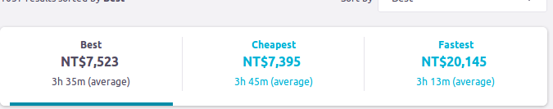
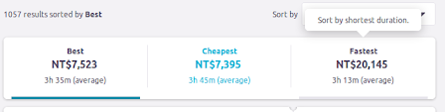
Analysis
Analysis:
  One user (Experienced, Taiwanese) didn’t notice what’s the fastest meaning on skyscanner at first.

Slide 44
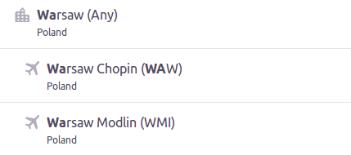
Analysis
Analysis:
  One user (Inexperienced, Taiwanese) didn’t notice that he can choose all airports at Warsaw.
    Because not familiar with Warsaw, he choose the wrong airport at first.
    But if he choose “Any” at first, he can avoid this problem.

Slide 45
Analysis
Question:
After very long year of hard work you decided to take a flight to Paris and rent a luxury
hotel. You want to depart 30/11/2018 and return 09/12/2018. You want to land on Charles de
Gaulle airport. You want to take the best possible flight when it comes to the price/time ratio.
During this time you want to reserve the best hotel when it comes to the user ratings.
Purpose:
Round-trip, Price/time ratio, hotel function
Analysis
  There are something wrong with our email account
  But when using user’s own account, it can login in successful
User 1 Taiwanese Experienced | User 2 Taiwanese Inexperienced | User 3 Foreigner Inexperienced | User 4 Foreigner Experienced
S | S | S | S

Slide 46
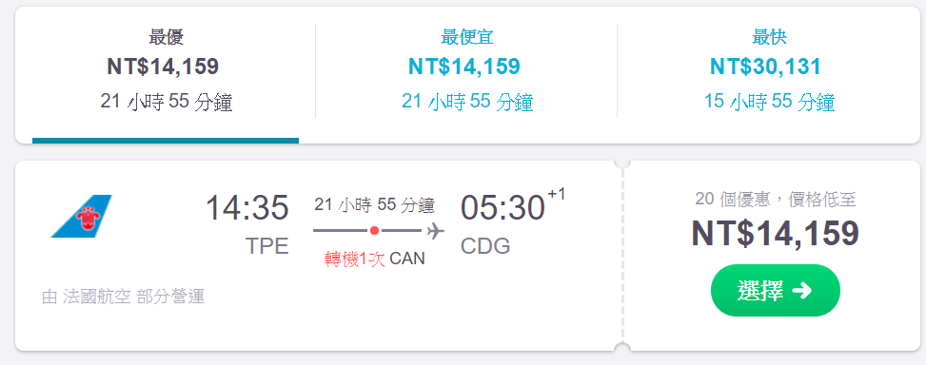
Analysis
Analysis
  Not sure the “Best” meaning

Slide 47
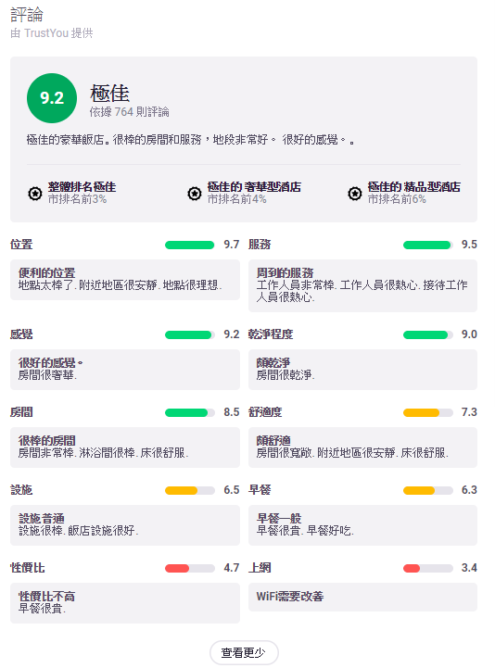
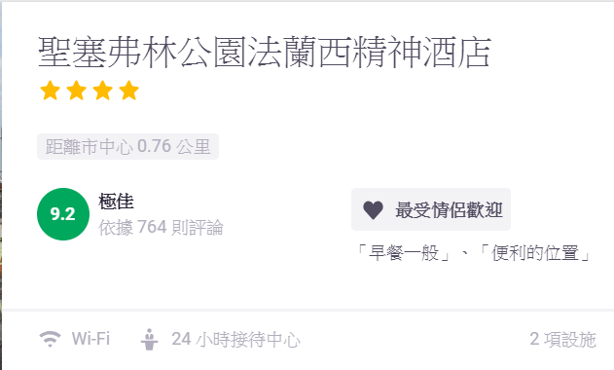
Analysis
Analysis
  The comments showing are limited

Slide 48
Analysis
Question:
During winter vacation, you want to take a trip to Tokyo with your friend for five days. Because you are students, you decided to find the cheapest round-trip tickets in January.
Purpose:
Test the function of finding whole month price
User 1 Taiwanese Experienced | User 2 Taiwanese Inexperienced | User 3 Foreigner Inexperienced | User 4 Foreigner Experienced
PS | S | S | S

Slide 49
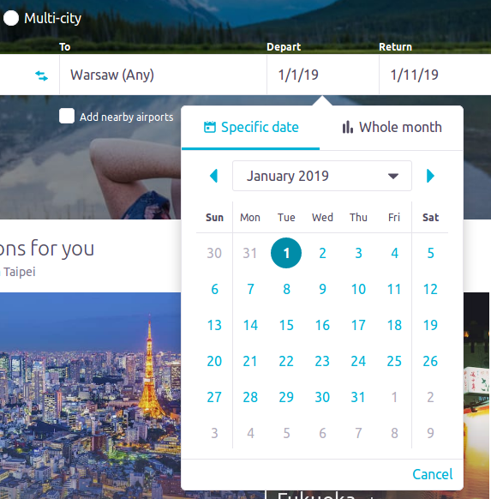
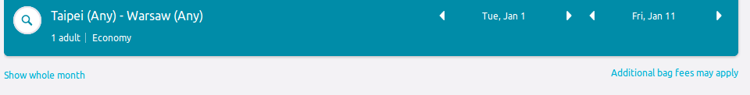
Analysis
Analysis
  One user take long time to find the function

Slide 50
Analysis
Question:
The typhoon is coming soon. The reporter said it will land on 2018/10/31. And now you are in
Tokyo. So you need to back to Taipei before Typhoon coming. And you want to choose a cheapest
ticket. Now, you only have a smartphone. So you need to use it to book a ticket.
Purpose:
Smartphone interface
User 1 Taiwanese Experienced | User 2 Taiwanese Inexperienced | User 3 Foreigner Inexperienced | User 4 Foreigner Experienced
S | PS | S | S

Slide 51
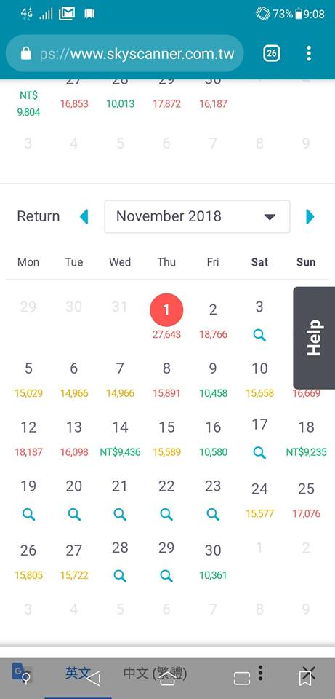
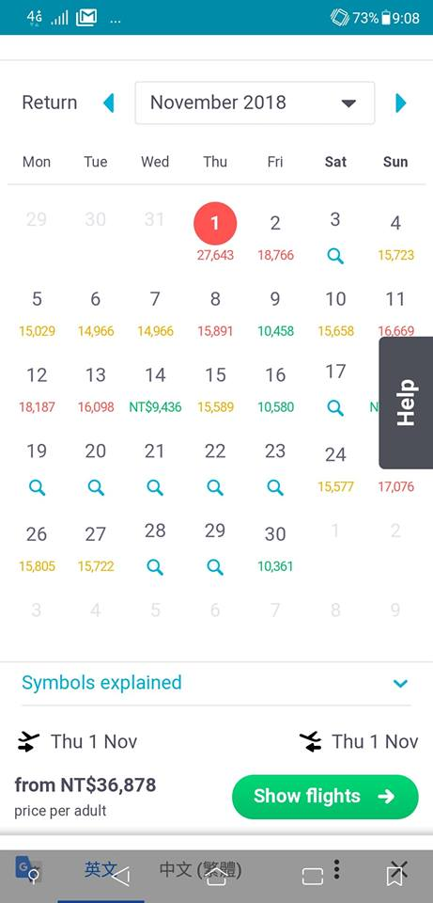
Analysis
Analysis
  Confuse with "magnifier" function
  User can provide traffic time to filter
some impossible flight.

Slide 52
Our evaluation
Almost Everyone can complete all the tasks, because Skyscanner is a well design website.
Foreigner
  Most of tasks are success
Taiwanese
  Interface problem
  Function not considered

Slide 53


